Slide 1

Welcome to Your
New Business!
Angi Holden-Secondary
Michele Rahn- Elementary

Slide 2
Goals for this session:
*What is Your “Business Plan”?
*Preparing for your
“Grand Opening”!
*It’s Easy! Let’s Review

Slide 3
Quick-Write…
Write down your responses to the following questions…
What is your favorite store?
Why do you like to shop there?
Why do you go back?

Slide 4
“Classroom Management skills are of primary importance in determining teaching success.”
Source: Classroom Management For Secondary Teachers, Classroom Management For Elementary Teachers. (2002)

Slide 5
“The number one factor in governing student learning is classroom management.”
Wang, Hartel, and Walberg (2009)

Slide 6
Effective teachers
MANAGE
their classrooms.
“Classroom Management refers to all things that a teacher does to organize student, space, time, materials, etc. so that student learning can take place.”
(Wong, “How to Be an Effective Teacher the First
Days of School” 2009)

Slide 7
Classroom Management must include the things a teacher does to:
*Foster Student Involvement and Cooperation in all Classroom Activities
*Establish a Productive Working Environment

Slide 8

What is Your
“Business Plan”?

Slide 9
Organizing for Instruction
“To begin establishing the positive climate for yourself and your students, you must consider the physical organization required for successful instruction.”
Archer & Hughes ,“Explicit Instruction: Effective and Efficient Teaching” (2011)

Slide 10
Organizing for Instruction
Designate areas for specific activities.
-whole group instruction
-small group instruction
-independent practice
-access to technology

Slide 11
Organizing for Instruction
2. Proximity
“Up Close & Personal”
-connect with students
-monitor behavior
-maintain attention
-engage in instruction

Slide 12
Organizing for Instruction
3. Students should face teacher during instruction.
“…a recent review of studies on room arrangement concluded that rows were more conducive that clusters to on-task behavior during independent work.”
(Wannarka&Ruhl, 2008)

Slide 13
Organizing for Instruction
4. Arrange seats so that students can easily share answers with partners.
-most effective and active participation

Slide 14
Organizing for Instruction
5. Organize both teacher and student materials for easy access.

Slide 15
Organizing for Instruction
6. Organize your room so that you can easily monitor student responses and provide feedback.

Slide 16
Organizing for Instruction
7. Organize so you can SEE
all parts of the room and all students.

Slide 17
Organizing for Instruction
8. Post materials on walls that support Instructional efforts.
-word walls, strategy posters, rubrics, content/reference information, rules & expectations, notices, calendars

Slide 18
“Power comes when
you make life
predictable for people”
Howard H. Stevenson

Slide 19

www.thingsorganizedneatly.com

Slide 20
We need to make school a predictable place where students want to be and want to come back!

Slide 21
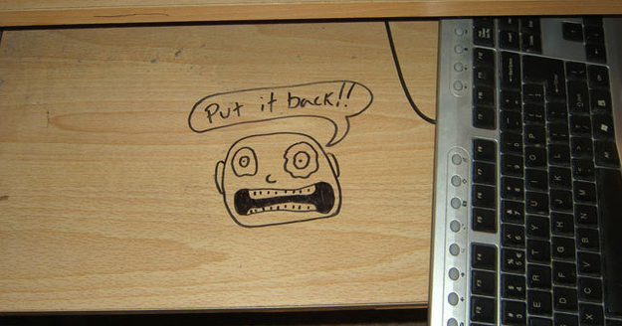

Slide 22
A Successful Business
Is Ready!
A Successful Educator is Ready!
Are YOU Ready?

Slide 23
Preparing for your “Grand Opening”

Slide 24
Grand Opening Checklist
Self-Evaluation
1. Review the “GRAND OPENING CHECKLIST”
2. Mark a “+” by the tasks you have completed.
3. Mark a “—” by the tasks you still need to address
4. Highlight your TOP FIVE tasks to complete in the next few days.
5. Share your goal with your elbow partner.

Slide 25
“The first day of school is the most important day of the school year. Effective Classroom management practices must begin on the first day of school.”
“The First Day of School” Educational Leadership

Slide 26

It’s Easy!
Let’s Review!

Slide 27
“The secret of getting ahead is getting started!”

Slide 28
“The best way to predict the future is to invent it.”

Slide 29
EXIT TICKET
CARPE DIEM!
List 10 things you want to have happen in your classroom
this school year!

