Slide 1
PEAKS Meeting
Jan. 26, 2012

Slide 2
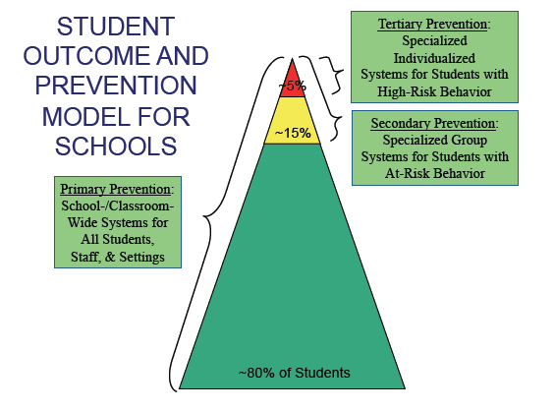
Notes:
Article Read

Slide 3
Article Read – Who’s a Tough Kid?
Read the short article from the Tough Kid Book
Underline 2 to 3 sentences that give you pause to think
Be prepared to share them with a neighbor.

Slide 6
Behavioral RtI
What/when/where are some of the predictable failures in your classroom?

Slide 7
The simplest things have the greatest impact
Downtime in your schedule can cause problems
Classroom structure can cause problems
Not circulating can cause problems

Slide 8
Influence Principles
Using “because”
Behavior reciprocation
Commitment and consistency
Social proof
Liking
Authority
Scarcity

Slide 10
More simple things to try FIRST
The evidence says . . .
Correction
-.74 Effect Size
Self Monitoring
-.97 Effect Size
Precision Requests
-.77 Effect Size

Slide 11
Correction
Punish incorrect response
Give opportunities to do it right
Praise the correct response

Slide 12
If that isn’t working . . .
Look for underlying issues – medical issues, academic issues, etc.
Problem Solve – talk to student, parent, other teachers.
Use other evidence based practices
Precision Commands
Self Monitoring
Social Skills

Slide 13
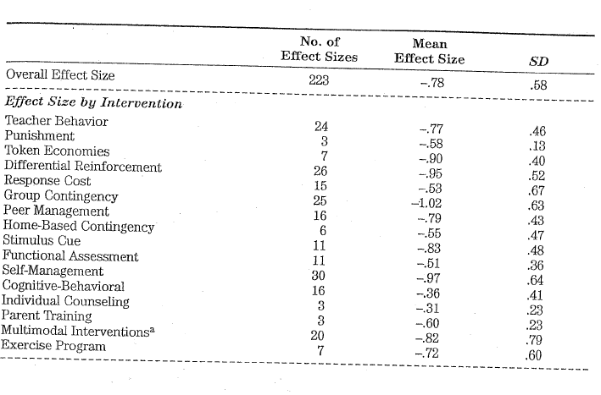

Slide 14
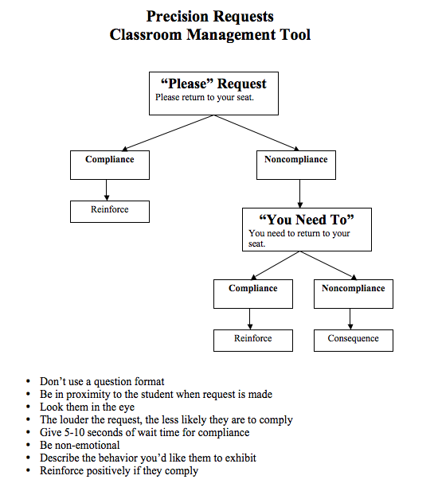
Effect Size -.77

Slide 15
Self Monitoring Effect Size -.97
Self monitoring for one behavior
Provide student with a form/table in the form of a grid (see form #1 below).
Set a timer to any amount of time (probably between 30 seconds and 15 minutes during the first couple of days).
When the timer sounds, the student makes one of two marks. A "plus" (+) sign, indicates that the student was engaging in the appropriate behavior (e.g., on-task, keeping hands to self, being quiet) at the exact moment that the bell sounded. A "minus" (-) sign, indicates that the student was NOT engaged in the appropriate assigned behavior when the bell sounded.

Slide 16
Self-monitoring for one behavior
"Grid" type of self-recording form

Slide 17
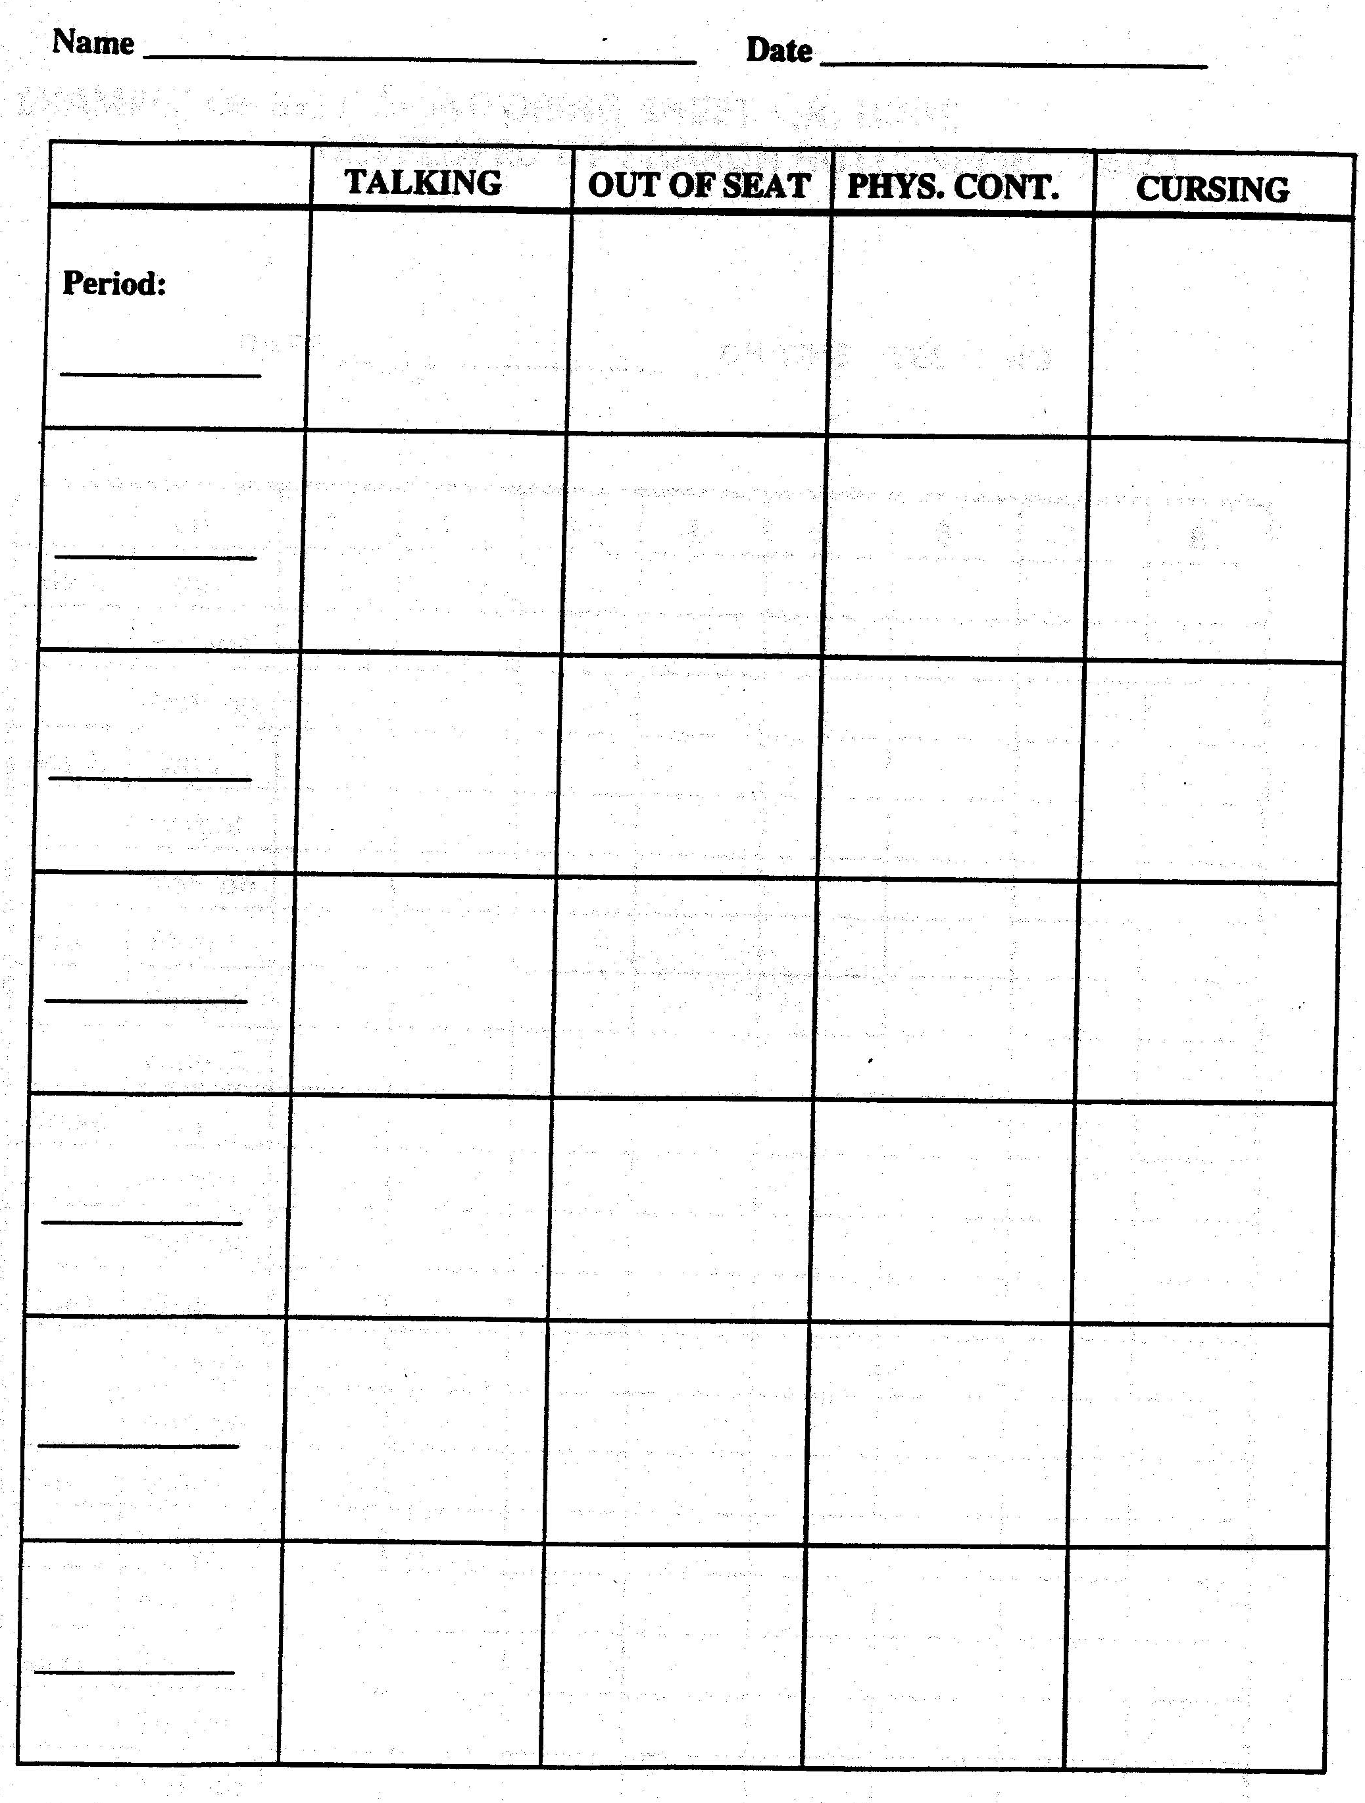
Self Monitoring Effect Size -.97
Multiple behavior, multiple period self-recording form

Slide 18
Social Skills- The Boys Town Model
Provides all students the explicit instruction they need to understand the social skill expectation.
Treats students with dignity, even when they mess up.
Adults model the desired behavior in tone of voice, facial expression and body language.

Slide 19
Boys Town Examples
How to Follow Directions
1. Look at the person
2. Say “OK”
3. Do the task immediately

Slide 20
Boys Town Examples
How to Stay on Task
1. Self start.
2. Work steadily for required time.
3. Sit straight and work quietly.
4. Remain awake.
5. Ignore distractions.
6. Maintain a pleasant face.
7. Ask for help when necessary.

Slide 21
Boys Town Examples
How to Get Teacher’s Attention
1. Look at the teacher.
2. Raise your hand.
3. Wait quietly for acknowledgment.
4. State question/answer specifically.

Slide 22
Did it Work?
Was it implemented with fidelity?
Was it implemented for a reasonable amount of time for it to work? (2 weeks)
There is no magic pill
Adjustments may need to be made, and when that happens, go back to the 4 essential questions.

Slide 23
Scenario
Walk through the 4 steps with one of the scenarios from teachers.

