Slide 1
Creating a Positive Classroom
Leslie Allen – Secondary PBIS Coach
Allan Whitmore – Elementary PBIS Coach

Slide 2
Task #1: Quick write
Think of a class/teacher where you had a positive experience. What were some of the characteristics of that classroom?

Slide 3
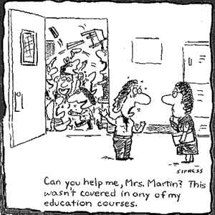
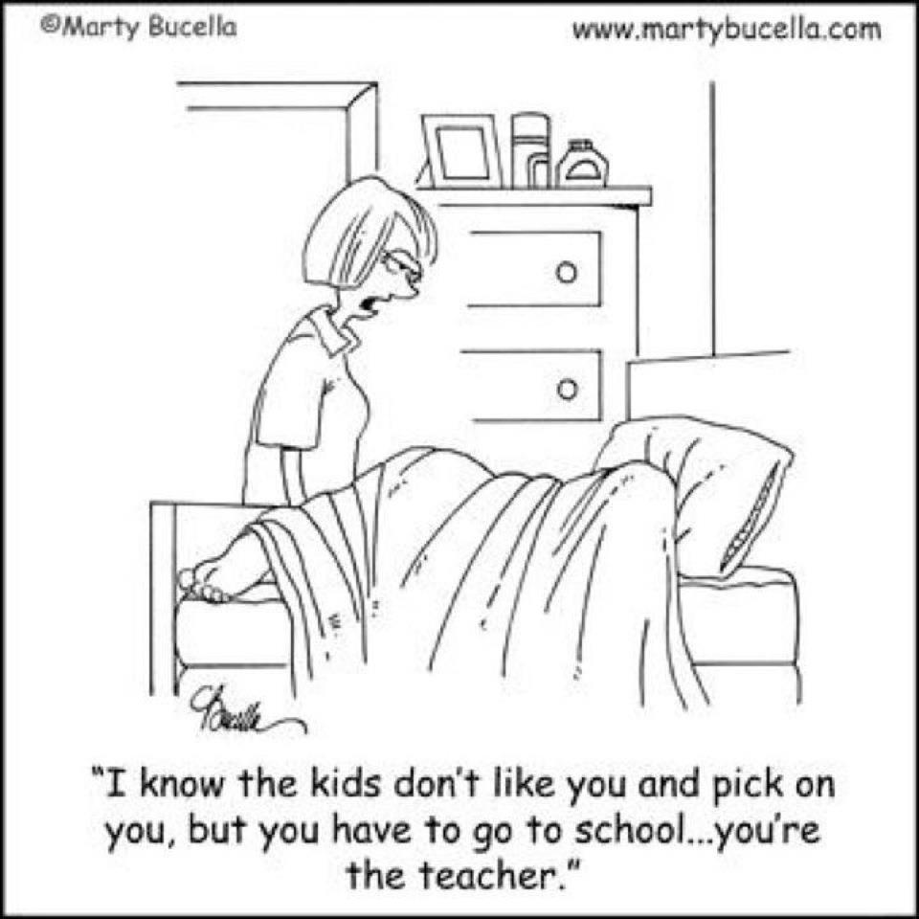

Slide 5
Establishing Expectations

Slide 6
Task #2: Developing Your Rules
Review the Characteristics of Good Practice Rules page with a partner.
Determine/Review your classroom rules. Keep in mind that they may have to merge with school rules . . .

Slide 7
Rules, Routines, & Arrangements
Rule: posted & briefly stated
Routine: problem context, times, groupings, etc.
Arrangements: physical boundaries, supervision, etc.

Slide 8
Establishing and Addressing Routines & Arrangements

Slide 9
Task #3: Predictions
Predict where you might have a failure in your classroom. . .
What might you do to be proactive about that? What rules, routines, or procedures might you put into place?
Notes:
Learning Task

Slide 10
Teach Expectations

Slide 11
Teaching Expectations
Explicitly teach all rules & routines!
Practice, practice, practice
Reinforce, reinforce, reinforce

Slide 12
Task 4: Article Read
Read through the section titled A Sample Procedure
Underline things you agree with
Circle things you have questions about

Slide 13
Reinforce Expectations

Slide 14
Task #5: Reinforcers
Turn to a partner and share a reinforcer that you used during student teaching, or that you experienced as a student in a class.
Be prepared to share out.

Slide 15
Success is more likely in the longer term when . ..
Prevention creates more positive than negative consequences
Failure
(Punishment)
Success
(Reinforcement)
4:1

Slide 16
Continuum of Reinforcement
Natural success
Nod, wink, etc.
Positive Comments
Public Acknowledgement
Token Acknowledgement
Privileges
Tangibles
Notes:
Potty Training Example

Slide 17
Correct Behaviors

Slide 18
Correct Behaviors
Use low key strategies for small problems:
Re-teach expectations
Move Seat
Take away privileges
Ignore
For bigger problems try:
Precision Requests

Slide 19
Problem Solving

Slide 20
Problem Solving
DON’T CHANGE THE RULES, CHANGE THE ROUTINE OR ARRANGMENTS IF PROBLEMS ARISE!

Slide 21
Establishing and Addressing Routines & Arrangements

Slide 22
Resources
New Teacher Coach – Secondary Schools
Achievement Coach – Elementary Schools
Invite them in to observe problem times and help you brainstorm what types of routines or arrangements you can change to make your classroom run more smoothly.

